Slide 1
UBISOFT DESIGN MASTERCLASS PRESENTATION DM Group 2
Ionut Vericiu - 3D Artist and Designer
Dragos Dumitru – Programmer and Designer

Slide 2
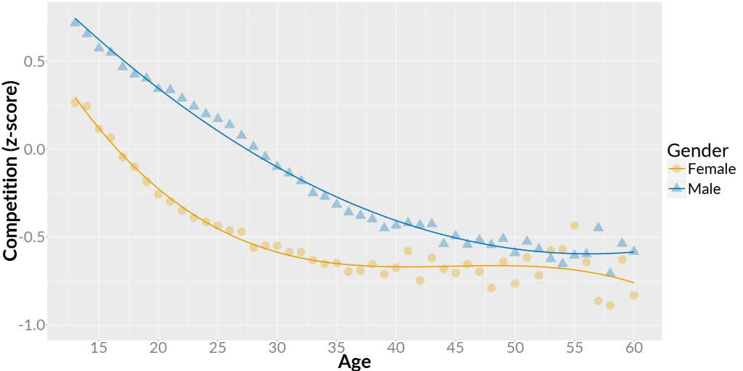
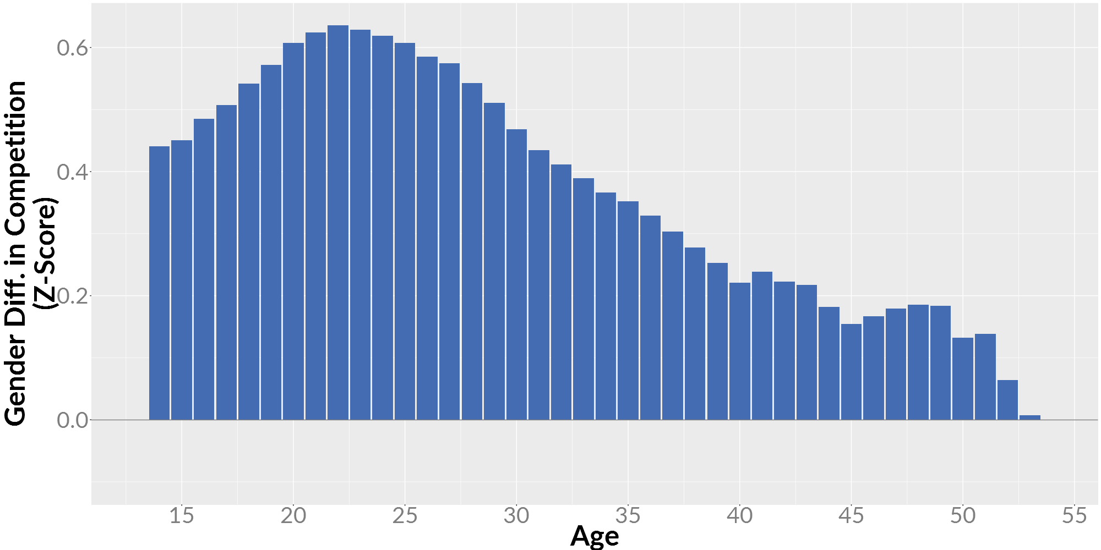
General
Genre: 2D fast paced physics-based local battle arena
Platform: PC
Target audience: (research link)
*male gamers (16-30 years old, enjoy competition and take delight in triumphing over adversary.

Slide 3
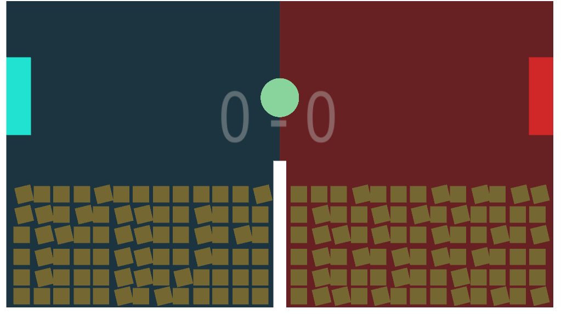
Gameplay
Short summary
Video showcase

Slide 4

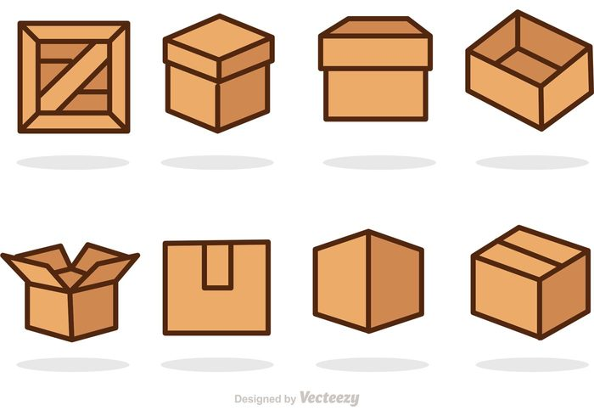

Art Style - Moodboards
High saturated colours;
Simple vector art-style;

Slide 5
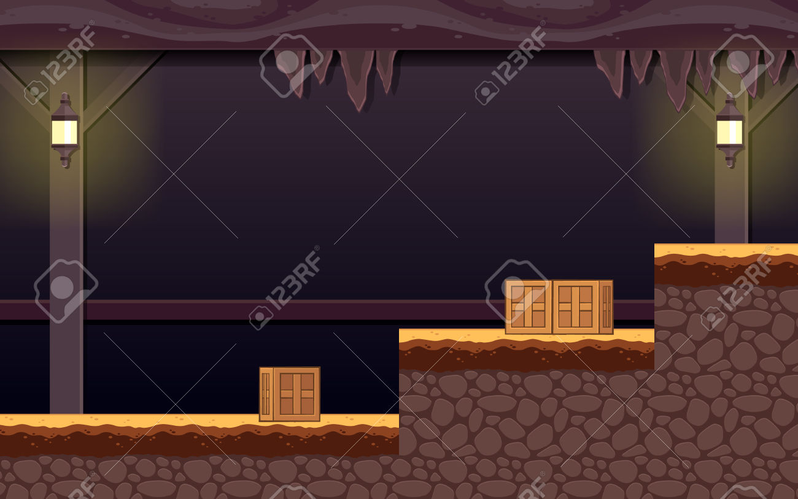
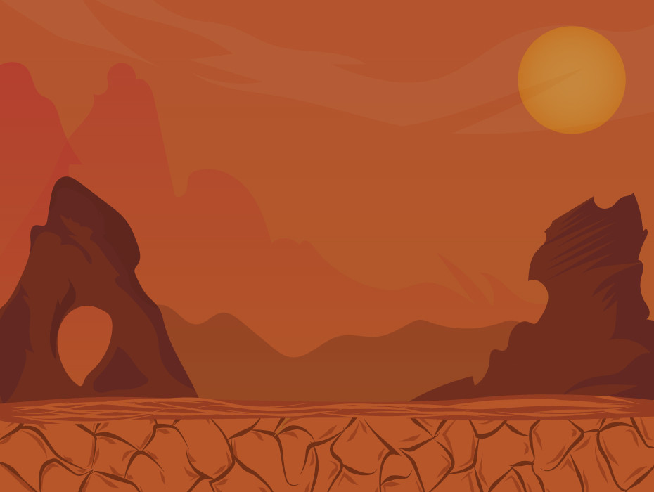
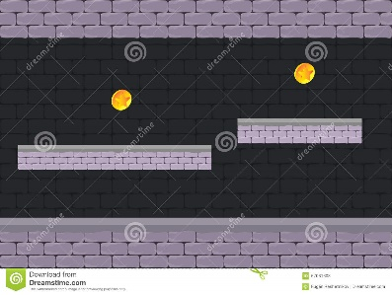
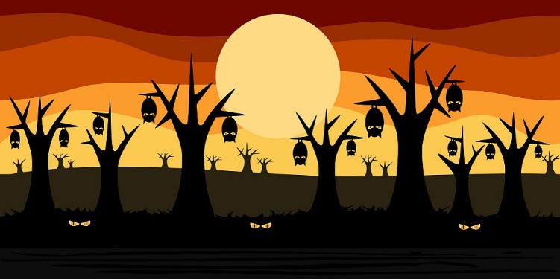

Slide 6
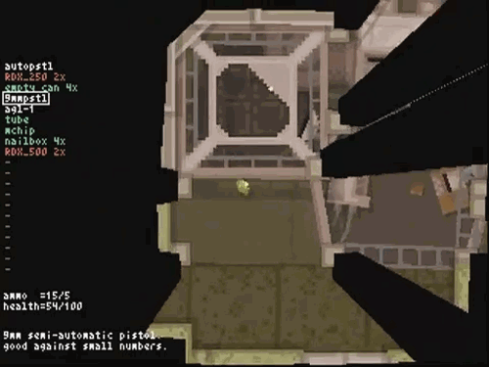
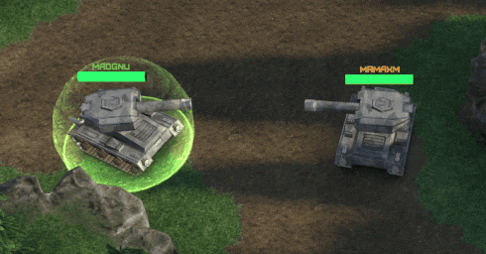
Effects
Camera shake
Chromatic aberration

Slide 7
Questions

